Slide 1
Evolution of Computers

Slide 2
What is a Computer?
Before we look at the evolution, we will look briefly at what we mean by the word computer.
Today a computer is defined as a device that can be programmed to carry out general purpose mathematical and/or logical computations.
A programmable computer is one that can carry out a large number of instructions given to it by the program that it is running.
It can also be reprogrammed so solutions to problems can be improved upon, or adapted.

Slide 3
What is a Computer?
A general purpose machine is a machine that can carry out a wide range of tasks to achieve a specific purpose.
A digital computer is one that operates using digital signals to transmit information. The digital signals have a value of 0 or 1.
An electronic computer is one that operates using electricity ie the movement of electrons through material. This material is typically a semiconductor.
Today’s computers are programmable, digital, electronic computers.

Slide 4
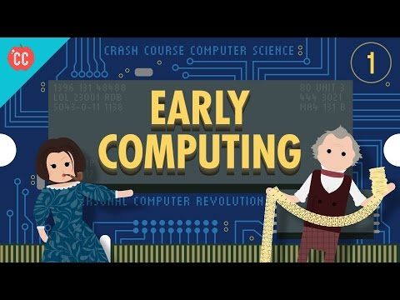
Early Computing

Slide 5
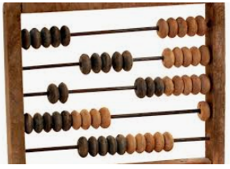
Early Computing
Humans have been calculating and computing for thousands of years. It is likely that they starting by using fingers, leading to the development of our base 10 number system.
Devices were invented to help calculations. The most famous of these is probably the Abacus. The abacus helped people to perform more advanced calculations. However, it was not a computing device, but an aid to the person who was doing the computing.

Slide 6

The First Computers
The first computers were actually people. As early as the 17th century, the term computer was used to mean a person who performed mathematical calculations.
In the early 1600’s a mechanical, analog computing device called a slide rule was invented.
Slide rules were continually improved and were able to calculate logarithms, trigonometric functions, squares, cubes and other complicated functions.
Slide rules were used by scientists and engineers until the 1970’s when they were replaced by pocket calculators.

Slide 7
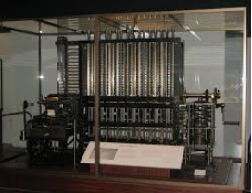
The Difference Engine
Eventually, mechanical devices using pulley, gears, levers and many moving parts were developed to deal with more advanced calculations.
In 1822 Charles Babbage designed the Difference Engine, a mechanical calculator that could solve polynomial functions.
The Difference Engine was about the size of a car and very complicated with thousands of moving parts.

Slide 8
The Analytical Engine
In the 1830’s, Babbage started working on the Analytical Engine.
It was a machine designed to carry out general purpose computations on data stored on punched cards.
The computations were specified by programs, also stored on punched cards. Designs for the Analytical Engine included mechanical memory and the equivalent of a CPU to carry out programmed instructions.
Due to lack of funding, the Analytical Engine was never completely built, but the designs that Babbage left behind were enough to demonstrate that the machine was programmable and arguably the first computer.

Slide 9
The first Computer Programmer
Ada Lovelace (1815 - 1852) is considered to have been the first computer programmer.
She became interested in Babbage’s Analytical Engine when she realised that it could be used for more than calculations but could also do general purpose computing.
Lovelace wrote programs for the Analytical Engine. She also wrote and published the first Algorithm designed to be executed by a machine.

Slide 10
Mechanical to Electronic
By the turn of the 20th century, many types of computers were devised, using mechanical, hydraulic and pneumatic means. They were all very large, complex and heavy. They were too expensive to produce in large quantities.
Soon electromechanical computers took over. These used electric switches to move mechanical parts.
The electromechanical Z3, developed in Germany in 1941 was the first digital, programmable computer to be built. The Z3 used binary numbers.

Slide 11
Second World War - Colossus and ENIAC
The second world war saw an increase in government and military spending on computers.
Colossus was the first fully programmable electronic computer.
It was invented and designed by Tommy Flowers and Alan Turing.
It made a major contribution to ending World War II when it helped to crack the codes of the German Enigma machines.
Simultaneously in the USA, Eckert and Mauchly built the ENIAC (Electronic Numerical Integrator and Computer) which is often considered to be the first example of a general purpose digital computer.

Slide 12
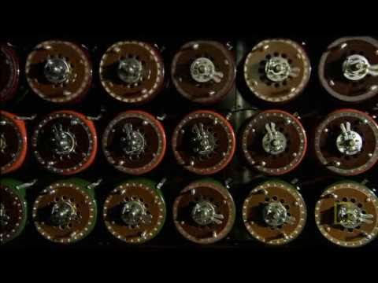

Slide 13
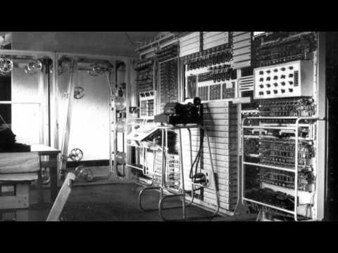

Slide 14
Components of first programmable computers
The first electronic computers, Colossus and ENIAC, weighed tonnes, occupied large rooms and were programmed by plugging and unplugging cables and by controlling various switches.
Military advances during WWII spurred innovation and fast tracked the invention of ENIAC.
The Colossus was rebuilt in Bletchley Park, the top secret British site of WWII decryption.
The Babbage analytical machine had 4 revolutionary features - input, storage, processing and output components.
Sequential flow control and looping operations were fundamental to his concept. Today, the inside of modern computers are not that different.

Slide 15
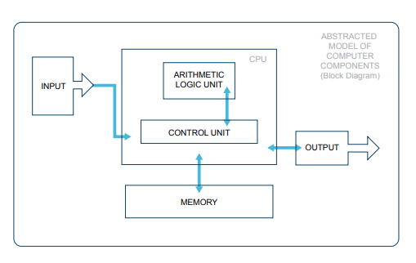
The Arithmetic Logic Unit (ALU) where instructions are actually carried out is probably the only functional unit that is extra to the original concept.

Slide 16
The complex relationship between society and computing technology is demonstrated clearly through the invention of the Colossus and ENIAC.
The Colossus had a real impact on the war, shortening it by 2 or 3 years. (https://www.bbc.com/news/technology-18419691)
Processing data, encrypting and deciphering codes and crunching numbers became key factors in deciding the outcome of WWII.
Many military innovations become mainstream technologies. The US Defence Advanced Research Projects Agency (DARPA) developed the Arpanet in the late 1960’s. It connected 4 nodes in the USA, developed IP addresses and invented TCP and UDP networking protocols. In the 1980’ s it evolved into the Internet.

Slide 17
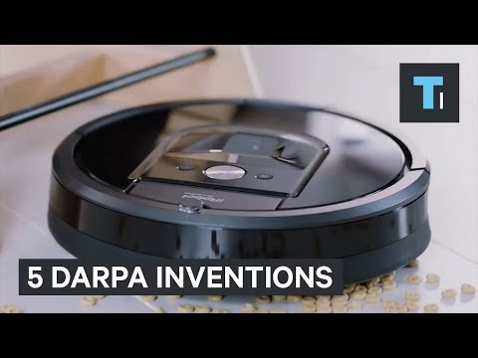
DARPA

Slide 18
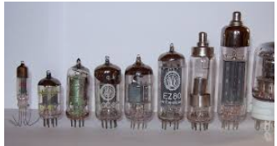
Vacuum tubes and electronic computers
Vacuum tubes are electrical devices that control the flow of electricity, The development of vacuum tubes (late 1940’s) led to the rapid growth of electronic devices including radio, television and computers.
These were the first all electronic computers. Their relatively small size, reliability and low cost led to them being developed at a rapid pace.
They became known as the first generation of computers.

Slide 19
Transistors
The replacement of vacuum tubes with transistors revolutionised electronics.
Transistors are tiny electronic switches. They could perform the same tasks as vacuum tubes but were much smaller as well as more reliable and cheaper.
The transistor was developed over many years but by the late 1950’s the technology had been perfected enough to change the electronics industry.
The computers based on transistors instead of vacuum tubes were the second generation of computers.

Slide 20
Integrated Circuits
The third generation of computers came about in the 1960’s. These computers were based on integrated circuits.
An integrated circuit consists of a number of electronic circuits all on a single semiconductor or “chip”.
The most famous 3rd generation computer was the Apollo Guidance Computer (AGC) designed at MIT. This computer helped to make the 1969 moon landing possible.
During the 1960’s and 1970’s third generation computers allowed the development of “minicomputers”. These were computers that were small enough to be moved between different locations easily.

Slide 21
Microprocessors
The fourth generation of computers is based on microprocessors. A microprocessor is what we now call a CPU (Central Processing Unit).
It is a device that takes binary input data and performs operations on that data from instructions stored in its memory, providing results as output. Most of today’s computers are of this generation.
The first microprocessor was developed in 1971 and was known as the Intel 4004. Today’s microprocessors contain billions of transistors on a single chip less than the size of your hand.
This allowed personal computers to become practical and affordable in the late 1970’s and early 1980’s.

Slide 22
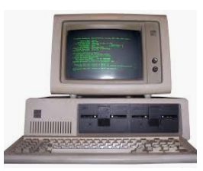
Personal Computers
The first personal computers or PC’s came in the late 1970’s/ early 1980’s from Commodore, Apple and IBM.
PC’s required computers to be usable by non experts. This led to the creation of user interfaces such as Microsoft Windows and hardware devices such as keyboards and mice.

Slide 23


Slide 24
Modern Computers
Today’s computers include laptops, tablets, PC’s and smart phones.
PC’s today cost hundreds of euro and have memory capacities and chips that operate at speeds that would have cost millions at the turn of the last century.
They are connected to the internet allowing them to access vast quantities of data.
The fastest computer today is approximately 5 million times faster than a normal laptop and 66 billion times faster than the CDC 6600, the first supercomputer from about 50 years ago.

